Slide 1
PROBLEM STATEMENT
Count palm oil trees from Unmanned Aerial Vehicle (UAV) Image
Used to do manually, time consuming
Automate the process using computer

Slide 2
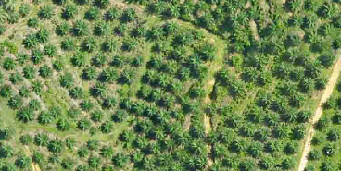
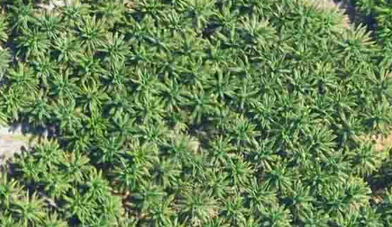
Sample Image

Slide 3
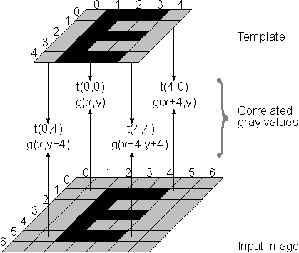
Method 1: Template Matching

Slide 4




Sample Template

Slide 5
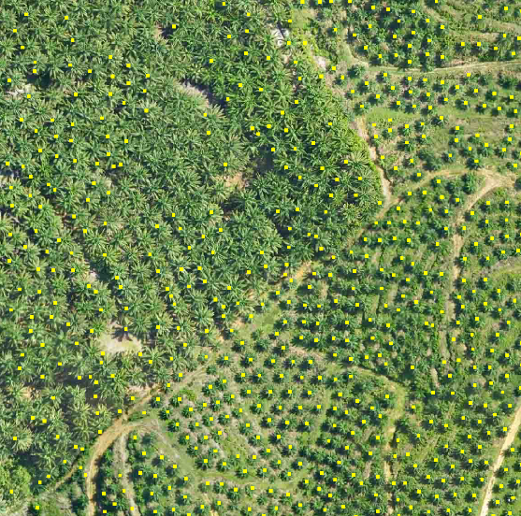
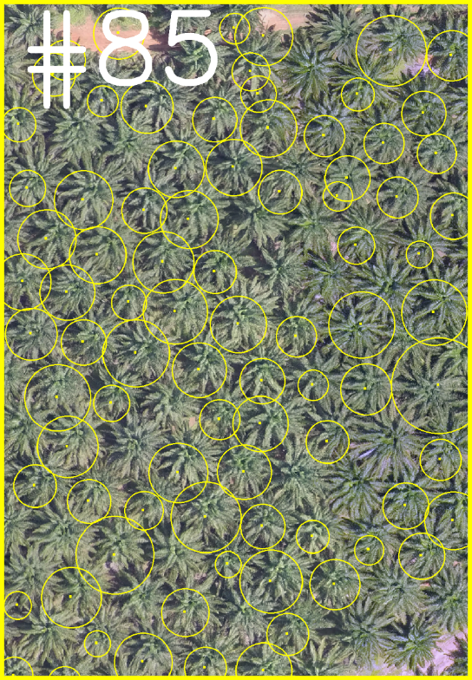
Result

Slide 6
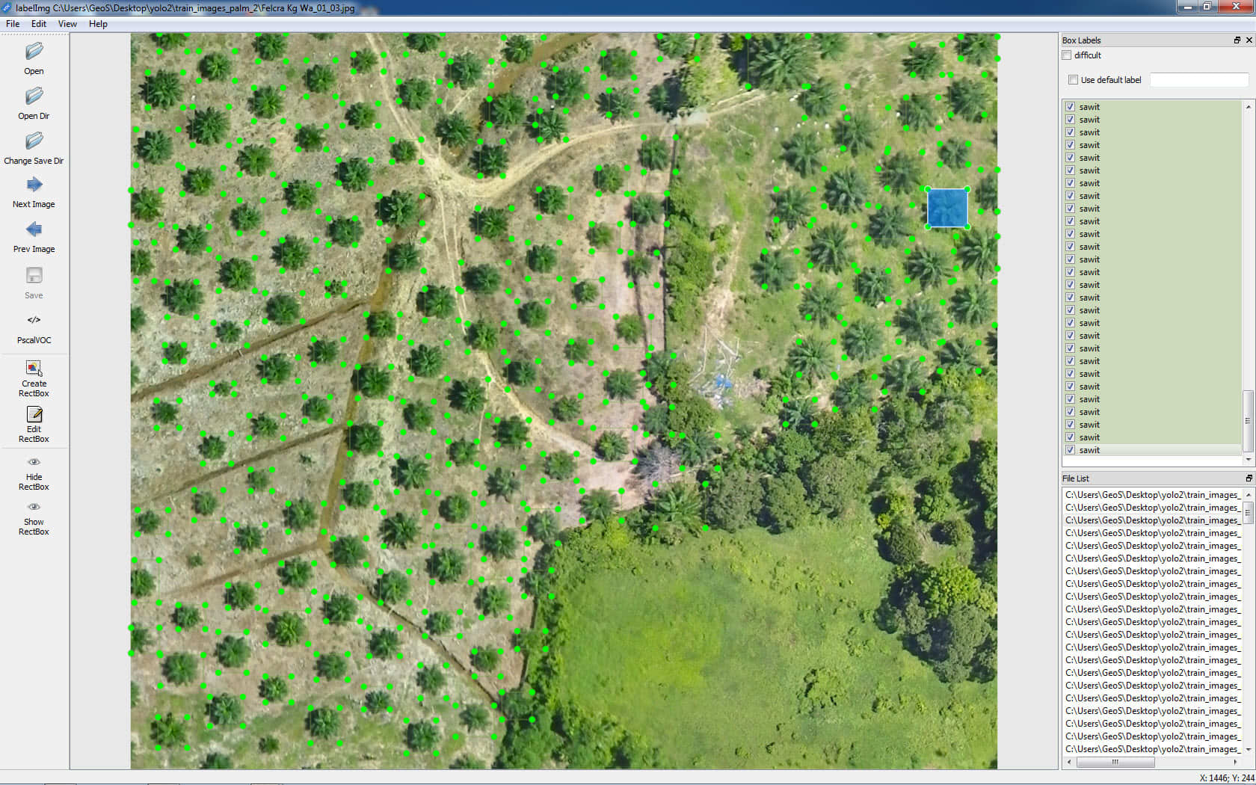
Method 2: Deep Learning Convolutional Neural Network
Annotate image using labelimg

Slide 7
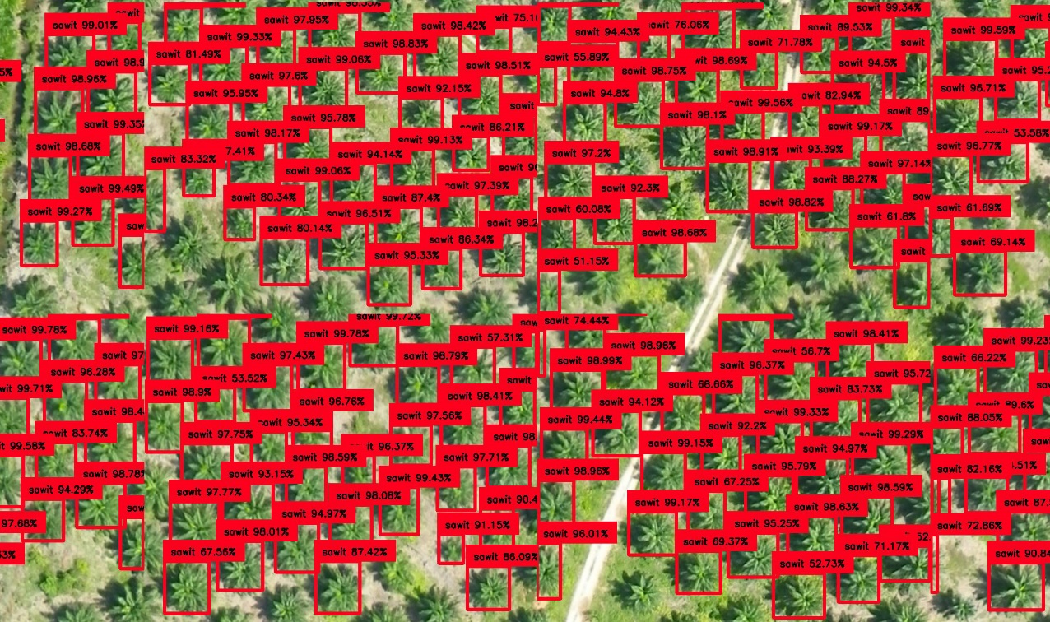
Result

